Slide 1

Classical Mechanics

Slide 2
Newton’s Laws of Motion
First Law: A body must continue in its state of rest or of uniform motion along a straight line unless acted upon by an external force.
Second Law: The rate of change of momentum is proportional to the impressed force and takes place in the direction of the force.
Third Law: To every action, there is an equal and opposite reaction.

Slide 3
Newton’s Laws of Motion
Key Points
The first law: Law of inertia
Second law: Limitation of the law is that the relation F=ma would not hold good in case m does not remain constant;
A falling raindrop, a rocket, particles with relativistic velocities

Slide 4
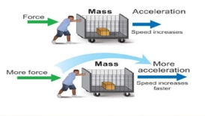
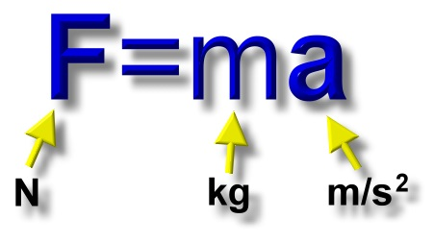
Newton’s Second Law of Motion
The rate of change of momentum of a body is proportional to the applied force and takes place in the direction in which the force act
.

Slide 5

If objects in motion tend to stay in motion, why don’t moving objects keep moving forever?
Things don’t keep moving forever because there’s almost always an unbalanced force acting upon it.
A book sliding across a table slows down and stops because of the force of friction.
If you throw a ball upwards it will eventually slow down and fall because of the force of gravity.

Slide 6
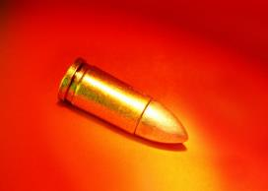
What does F = ma say?
F = ma basically means that the force of an object comes from its mass and its acceleration.
Something very massive (high mass) that’s changing velocity very slowly (low acceleration), like a glacier, can still have great force.
Something very small (low mass) that’s changing velocity very quickly (high acceleration), like a bullet, can still have a great force.

Slide 7
More Examples from Real Life
A powerful locomotive begins to pull a long line of boxcars that were sitting at rest. Since the boxcars are so massive, they have a great deal of inertia and it takes a large force to change their motion. Once they are moving, it takes a large force to stop them.
On your way to school, a bug flies into your windshield. Since the bug is so small, it has very little inertia and exerts a very small force on your car (so small that you don’t even feel it).

Slide 8
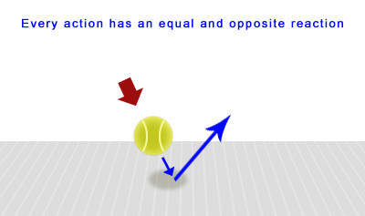
Newton’s Third Law of Motion
Every action there is an equal and opposite reaction.
The action and reaction act on different bodies

Slide 9
Newton’s Third Law
For every action there is an equal and opposite reaction.
Right now, gravity is pulling you down in your seat, but Newton’s Third Law says your seat is pushing up against you with equal force.
This is why you are not moving. There is a balanced force acting on you– gravity pulling down, your seat pushing up.

Slide 10
Think about it . . .
What happens if you are standing on a skateboard or a slippery floor and push against a wall?
You slide in the opposite direction (away from the wall), because you pushed on the wall but the wall pushed back on you with equal and opposite force.
Why does it hurt so much when you stub your toe?
When your toe exerts a force on a rock, the rock exerts an equal force back on your toe. The harder you hit your toe against it, the more force the rock exerts back on your toe (and the more your toe hurts).

Slide 11
Frames of Reference
A set of criteria or stated values in relation to which measurements or judgements can be made
An arbitrary set of axes with reference to which the position or motion of something is described or physical laws are formulated.

Slide 12
Frames of Reference
Inertial
Non-inertial
Inertial Frame of Reference: As long as the frame of reference is not moving or moving with a constant velocity it is termed as an inertial frame of reference.
Example: a car at standstill or a bus moving with constant speed are considered to be inertial frames of reference.

Slide 13
Non-Inertial Frame of Reference: If the frame is accelerating or moving in a circular path with constant speed, it is termed as a non-inertial frame of reference.
Earth: As the earth performs circular motion about its axis, it must have acceleration (centripetal) so it is non-inertial frame of reference.
►Newton's first law always seen wrong in the accelerating frame because An object is a rest at an inertial frame can see accelerating in a non-inertial frame even though no force acting on it. So, the newton's first law of motion is valid on inertial frame of reference.

Slide 14
Is Newton's second law is invalid in non-inertial frame ?
Third law is on inertial or non-inertial frame ?

Slide 15
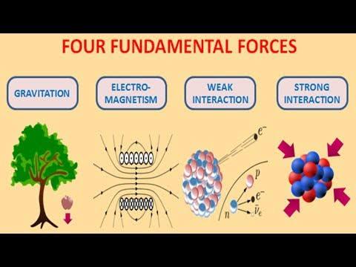
Fundamental Forces
Notes:
https://www.youtube.com/watch?v=669QUJrF4u0

Slide 16
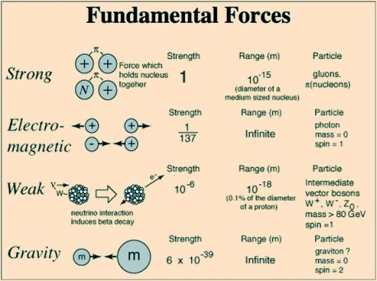

Slide 21
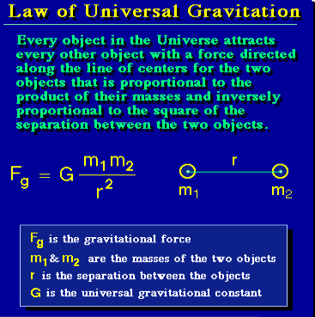
Gravitation
The force of gravity is directly proportional to the mass of the earth, the mass of the object and inversely proportional to the distance between the object and the earths centre.

Slide 22
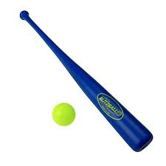
Gravity
G is the force of gravitation which exists between two bodies of unit mass kept at a unit distance
If they attract Why they are not sticking to each other
Note :The value of G very small and hence gravitational force is considered to be one of the weakest force.

Slide 23
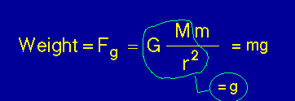
Weight and Mass
Mass is the measure of how much material in a object
Weight is the gravitational force exerted on that mass when placed in gravitational field
Mass will be a constant everywhere, whereas the weight changes according to the place.

Slide 24
* The resistance that one object or substance encounter when moving over another body/surface

Slide 26
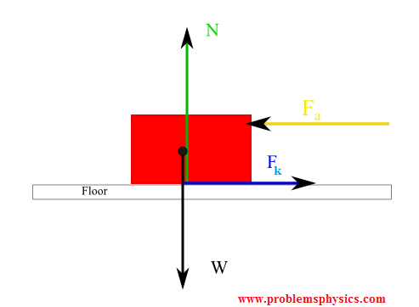
Friction
When two bodies are in contact with each other, the particles at the surface of the two bodies exerts an electromagnetic force between each other.
The force has a normal and horizontal component
The normal component is called normal force or normal contact force
Friction is the horizontal component of the contact force

Slide 27
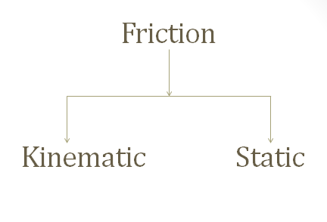
Friction
Always act tangential on the surface
Always resist relative motion
Friction force =-applied force
Independent of the surface area of the surface at contact
Types of Friction

Slide 29
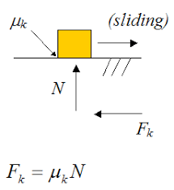
Kinematic Friction
When two bodies are in contact and bodies in contact slip over one another the friction generated is kinematic friction

Slide 30
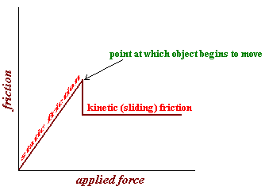
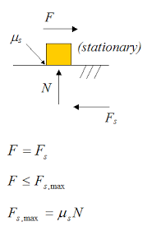
Static Friction
Limiting friction

Slide 31
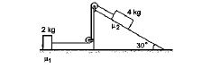
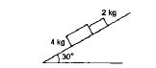
Numerical
Q1: A block slides down an inclined surface of inclination 30° with the horizontal. Starting from rest it covers 8 m in the first two seconds. Find the coefficient of kinetic friction between the two
Ans: 0.1
Q2: If the tension in the string in figure
is 16 N and the acceleration of each block is
0.5 m/s², find the friction coefficients at the
two contacts with the blocks.
Ans: μ2=0.06 and μ1=0.75
Q3: Figure shows two blocks in contact sliding down
an inclined surface of inclination 30°. The friction
coefficient between the block of mass 2.0 kg and the
incline is μ₁ and that between the block of mass 4.0 kg and the incline is μ₂ Calculate the acceleration of the 2.0 kg block if (a) μ₁ = 0.20 and μ₂ = 0.30, (b) μ₁ = 0.10 and μ₂ = 0.20. Take g = 10 m/s 2.
Ans: (a) 2.7 m/s2 (b) 3.5 m/s2

Slide 32
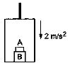
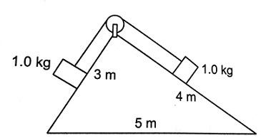
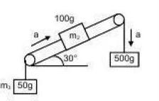
Numerical
Q1: The elevator shown in figure is descending with an
acceleration of 2 m/s² . The mass of the block A is 0.5 kg.
Mass of B block 1 Kg.
What force is exerted by the block A on the block B ?
(no frictional forces associated) Ans: 4N
Q2: Consider the situation shown in figure . All the
surfaces are frictionless and the string and the pulley
are light. Find the magnitude of the acceleration of the
two blocks. Ans: 1 m/s
Q3: Find the acceleration of 500gm block.
Assume frictionless case (No friction is involved)
Ans: 6.1 m/s2

Slide 33
Numeric
Q1: Find the percentage decrease in the weight of a body when taken 32 km below the surface of the earth. Take radius of earth = 6400 km
Q2: Three masses of 5 kg each are kept at the vertices of an equilateral triangle each of side 0.25m. Find the resultant force on one of the masses.
Q3: A satellite of mass 1000 kg moves in a circular orbit of radius 7000 km around the earth. Calculate the total energy required to place the satellite in orbit from earth’s surface. Take radius of earth = 6400 km and g = 10.0 m/s² .

Slide 34
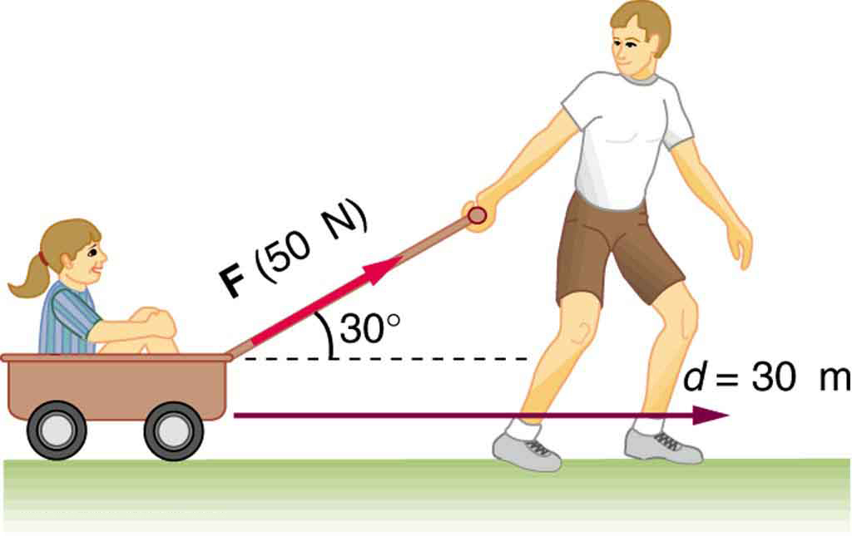
Work and Energy
Energy is the capacity of a physical system to do work
Work, energy transferred by a force
Or
Force multiplied by displacement of point of the application of force in the direction of force.

Slide 36
Work and Energy
Hence ,
Work =Force X displacement
(Nm-Joule)
UNIT in SI
Work and Energy: Joule (Nm)=Kgm⁻²s⁻²

Slide 40
Different Forms of Energy
Kinetic Energy | Potential Energy
Motion | Gravitational
Thermal energy | Chemical
Sound | Nuclear
Electromagnetic | Elastic
Electric | -

Slide 41
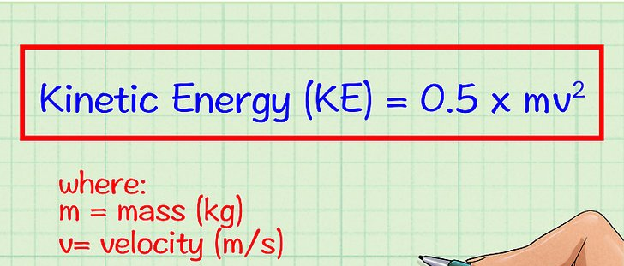
Kinetic Energy
Kinetic energy is the work done by a force F to produce movement in an object from its initial position to the final position

Slide 42
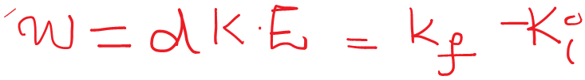

Slide 44
Conservative & Non-conservative Force
If the work done by a force depends only on the initial and final state and not on the path taken, then it is called a conservative force.
Example of conservative force: Gravity and coulomb force
Example of non-conservative force : force of friction

Slide 45
Power
Power: Rate of work done
Unit: Watt or Joule/second

Slide 46
Potential energy
the energy possessed by a body by virtue of its position relative to others, stresses within itself, electric charge, and other factors.
Potential energy at a constant height
Potential energy due to spring motion, Hooke’s law

Slide 48
Law of Conservation of Mechanical Energy
For a system of conservative forces and if there is no external force acting on the system, work done by the system to change the potential energy of the body from its initial position to final position will be
Upon rearranging
The total mechanical energy of a system remains constant if the internal forces are conservative and external forces do not work

Slide 49
Numerical – Sample Problems
Q1: A block of mass 2.0 kg is pulled up on a smooth incline of angle 30° with the horizontal. If the block moves with an acceleration of 1.0 m/s2, find the power delivered by the pulling force at a time 4.0 s after the motion starts. What is the average power delivered during the 4.0 s after the motion starts?
Q2: a particle is placed at the point A of a frictionless track ABC . where point a is at a height of 1m point b at 0.5m and point c at little less than point a . it is pushed slightly towards right. find its speed when it reaches the point B take
Q3: A body dropped from a height H reaches the ground with a speed of 1.2 root (mgh). Calculate the work done by air-friction.
Q4: A force F = (10 + 0.50 x) acts on a particle in the x direction, where F is in newton and x in meter. Find the work done by this force during a displacement from x = 0 to x = 2.0 m.

Slide 50
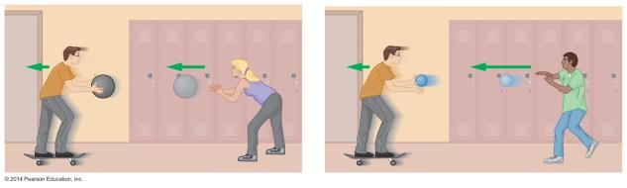
Momentum
How can the effect of catching a slow, heavy object be the same as catching a fast, lightweight object? The answer: They have the same momentum.
Momentum is defined as the mass times the velocity. The symbol for momentum is

Slide 51
…Momentum…
Since momentum is the product of mass and velocity, an object's momentum changes whenever its mass or velocity changes.
The units of momentum are kg•m/s
is sometimes referred to as the linear momentum to distinguish it from angular momentum, a quantity associated with a rotating object.
Momentum is a vector quantity. The momentum vector points in the same direction as the velocity vector.

Slide 52
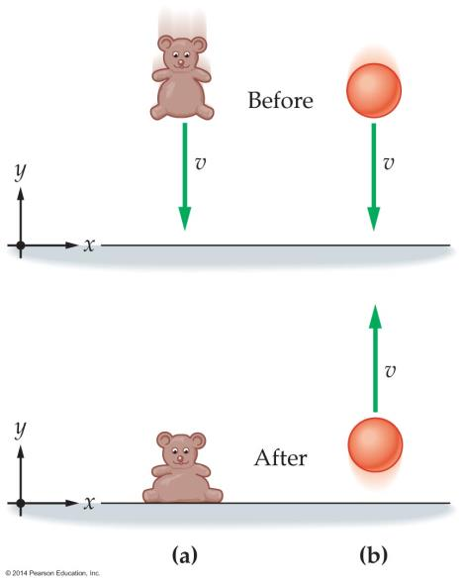
…Momentum…
In these figures two objects, a beanbag bear and a rubber ball, are shown, each with the same mass and same downward speed just before hitting the floor.
What is the change in momentum of each of the objects?

Slide 53
…Momentum…
If the beanbag has a mass of 1 kg and is moving downward with a speed of 4 m/s just before coming to rest on the floor, then its change in momentum is
A 1-kg rubber ball with a speed of 4 m/s just after hitting the floor will bounce upward with the same speed. Therefore, the change in ball's momentum is

Slide 54
…Momentum…
The total momentum of a system of objects is the vector sum of the momentums of all the individual objects:
Due to the vector nature of momentum, it is possible for a system of several moving objects to have a total momentum that is positive, negative, or zero.

Slide 55
Impulse
The product of a force and the time over which it acts is defined as the impulse
Because impulse involves the product of force and time, a small force acting over a long time has the same effect as a large force acting over a short time.
The units of impulse are the same as the units of momentum, namely, kg•m/s.
Impulse is a vector that points in the same direction as the force.

Slide 56
Impulse
The following example illustrates how impulse is calculated.

Slide 57
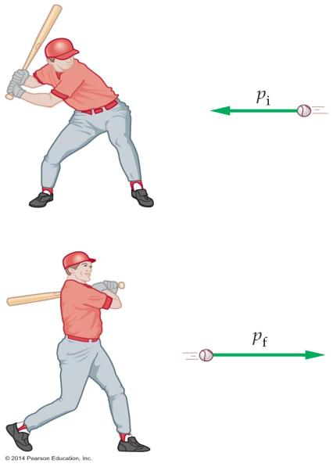
As the figure indicates, when a force acts on an object, it changes the object's momentum.
This means there must be a connection between impulse and momentum change. This connection is revealed through the general form of Newton's second law:

Slide 58
Rearranging this equation, we get
Therefore, the relationship between the impulse and momentum change is as follows:

Slide 59
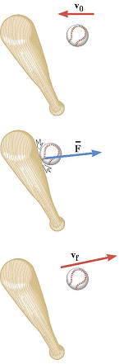
Impulse-Momentum Theorem
When a net force acts on an object, the impulse of this force is equal to the change in momentum of the object:
Impulse
Final momentum
Initial momentum
Impulse=Change in momentum

Slide 60
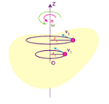
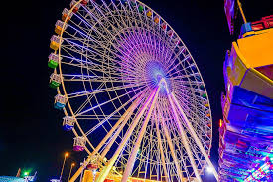
Rotational Motion
Axis of rotation: If each particle in a rigid body moves in a circle and the centre of the circles lies in a straight line, then the plane of all the circles traced by the particles are perpendicular to the straight line. Then the body is said to be rotating about a line and this line is called the axis of rotation. E.g. Fan, Gas stove nob etc.
For all the particles exhibit circular motion . The particles near to the line move less faster as compared to the particles away from the straight line. Hence all the particles covers one rotation at the same time

Slide 61
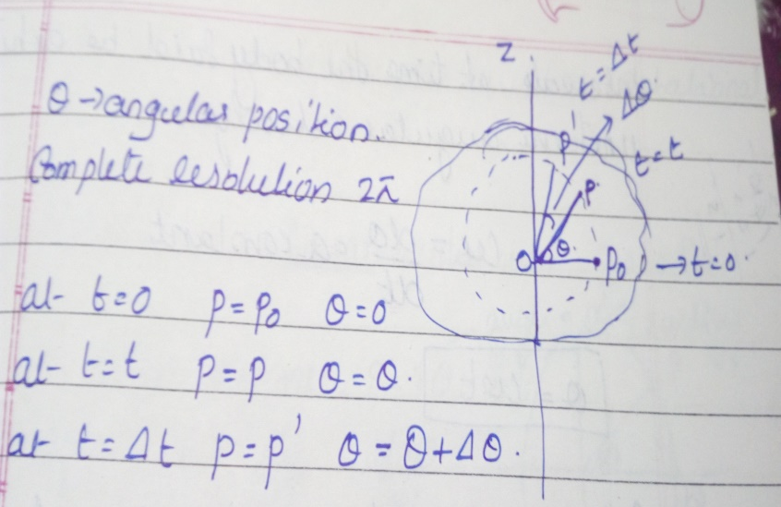
Rotational motion
is the Angular position
Angular velocity ,
SI unit of angular velocity is radian/seconds
For uniform angular acceleration,

Slide 62
Rotational Motion
If the body is not covering equal angles at equal intervals of time, then the body is said to be have a rotational acceleration
Angular acceleration
If Angular acceleration is constant

Slide 63
Rotational Motion
Relation between linear motion and rotation
Where, v is the linear velocity and a is the linear acceleration
* When a rigid object is rotating about a fixed axis, every particle on the object rotates through the same angle in a given time interval and has the same angular speed and the same angular acceleration.

Slide 64
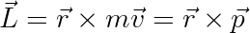
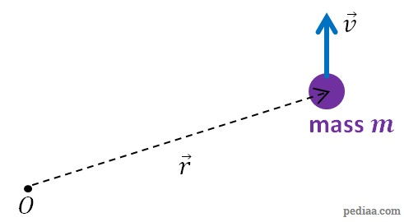
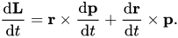
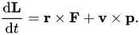
Angular momentum
For an object with mass m moving at a velocity v, the angular momentum L with respect to a reference point is defined using the cross product as:
where is the position vector of the object that describes the object’s position with respect to the reference point.
V x P = 0, as they are parallel
By definition, torque τ =r × F =
Linear momentum is a property of objects which are changing their position with respect to a reference point.
Angular momentum is a property of objects which are changing the angle of their position vector with respect to a reference point.

Slide 65
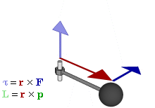
Torque
The force responsible to produce rotation is called torque. Torque is the rotational equivalent of linear force.
The total external torque acting on a system can be defined as the product of angular acceleration and the momentum of inertia of the system
OR

Slide 66
The equation of motion for a rigid body rotating about fixed axis:
dW = τ dθ.
This represents the work done by the total torque that acts on the rigid body rotating about a fixed axis.

Slide 67
Numerical
Q1: A uniform circular disc of mass 200 g and radius 4.0 cm is rotated about one of its diameter at an angular speed of 10 rad/s. Find the kinetic energy of the disc and its angular momentum about the axis of rotation.
Q2: A wheel rotating at an angular speed of 20 rad/s is brought to rest by a constant torque in 4.0 seconds. If the moment of inertia of the wheel about the axis of rotation is 0.20 kg-m 2, find the work done by the torque in the first two seconds.
Q3: A wheel rotating at a speed of 600 rpm (revolutions per minute) about its axis is brought to rest by applying a constant torque for 10 seconds. Find the angular deceleration and the angular velocity 5 seconds after the application of the torque.

Slide 68
A uniform circular disc of mass 200 g and radius 4.0 cm is rotated about one of its diameter at an angular speed of 10 rad/s. Find the kinetic energy of the disc and its angular momentum about the axis of rotation.

Slide 71
Rigid Body
A body that does not change shape under the influence of forces is known as a Rigid Body.

